Slide 1
Course MongoDB

Slide 2
Topics (1)
Database models
SQL vs NoSQL
Introduction to MongoDB
CRUD operation
How to design schema of MongoDB
Improve performance

Slide 3
Topics (2)
Administration tasks
Scalable
Security
Monitoring and Operation

Slide 4
Database Models

Slide 5
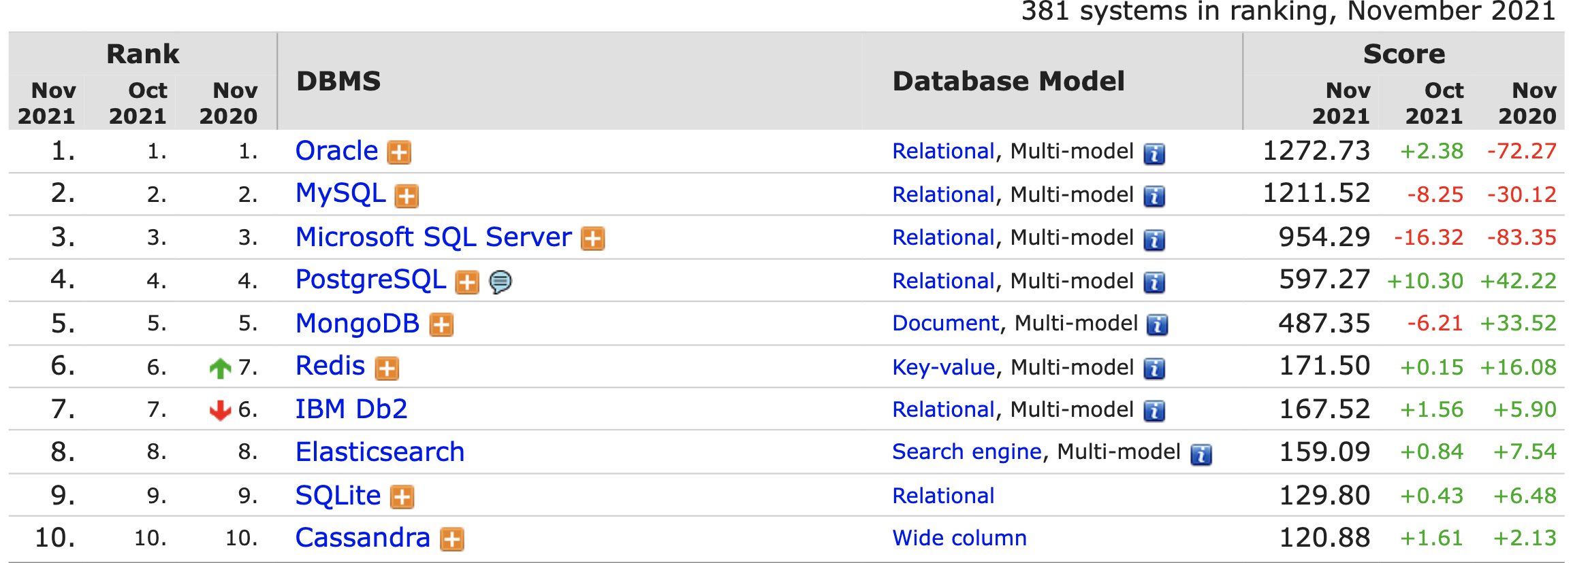
Database ranking
https://db-engines.com/en/ranking

Slide 6
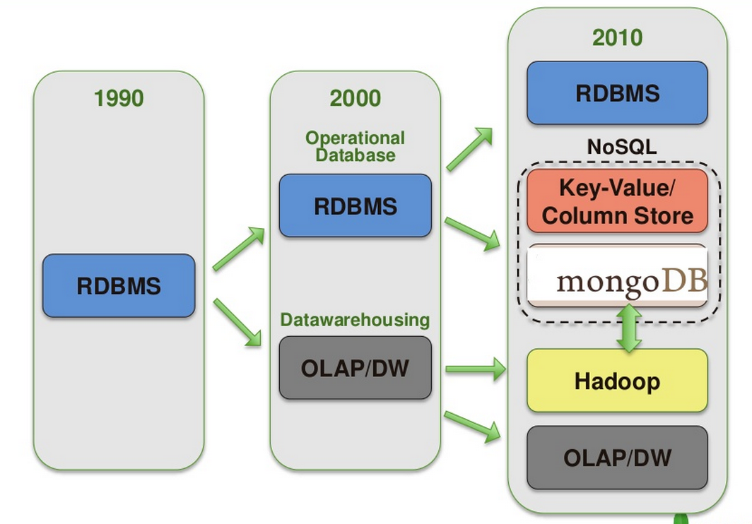
Evolution of database

Slide 7
Polyglot Database
https://martinfowler.com/bliki/PolyglotPersistence.html

Slide 8
Polyglot Database

Slide 9
NoSQL
Not Only SQL
Non-relation
No join
No complex transaction
Focus on horizontal scalable
Need new database model

Slide 10
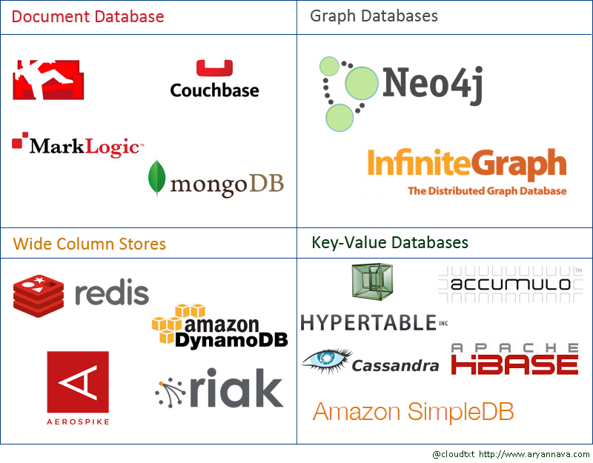
NoSQL World

Slide 11
CAP Theorem

Slide 12
MongoDB

Slide 13
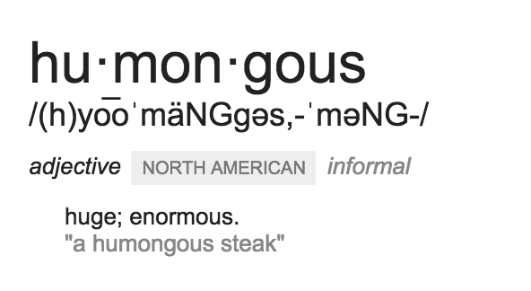
MongoDB
Humongous

Slide 14
MongoDB
Open sources
Scalable
High-performance
Schema-free, dynamic schema
Document-oriented database

Slide 15
MongoDB
NoSQL documentDB
Stored in collections

Slide 16
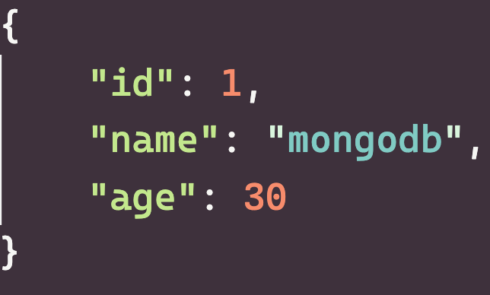
Document
Way to organize and store data
Set of field-values pairs

Slide 17
JSON format
JavaScript Object Notation
Start and end with { }
Separate each key and value with :
Separate each key-value with ,
Text-based format

Slide 18
JSON use cases
APIs
Configuration files
Log message
Database storage

Slide 19
JSON as database
Text-based format (passing is very slow)
Less space-efficient
Only support a limited number of data types

Slide 20
BSON
Binary JSON
Bridges the gap between binary and JSON format
https://bsonspec.org/

Slide 21
BSON Goals
Speed
Space
Flexibility
Designed for high performance

Slide 22
JSON vs BSON
 | JSON | BSON
Encoding | UTF-8 string | Binary
Data types | String, Boolean, Number, Array | String, Boolean, Number, Array, Date, Binary
Readability | Human and Machine | Machine only
https://www.mongodb.com/json-and-bson

Slide 23
Summary
BSON => store
MongoDB stores data in BSOB, internally and over the network
JSON => view
Can be natively stored and retrieved in MongoDB
https://bsonspec.org/

Slide 24
RDBMS vs MongoDB
Database
Table
Row
Column
Database
Collection
Document
(JSON, BSON)
Field
https://docs.mongodb.com/manual/reference/sql-comparison/

Slide 25
Collection in MongoDB
An organized store of documents
Collection name = order
Document 1
Document 2
Document 3

Slide 26
Collections types
Default
Views
On-demand material views
Capped collection (fixed-size)
Time series collection

Slide 27
Installation

Slide 28
Choices
On premise
On cloud

Slide 29
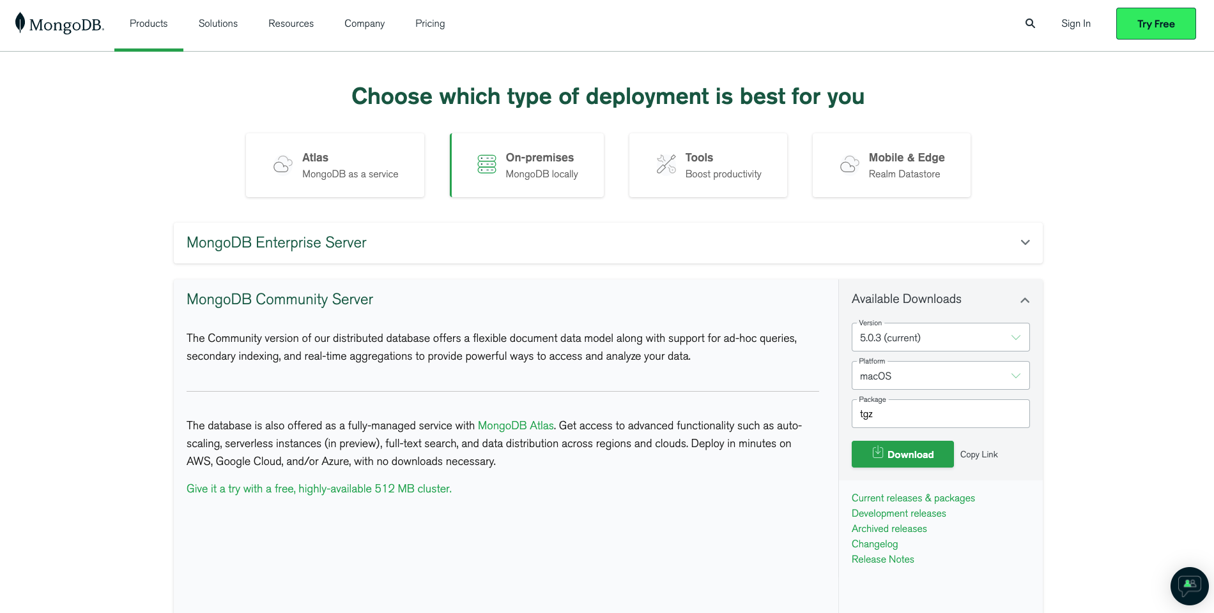
On premise
https://www.mongodb.com/try/download/community

Slide 30
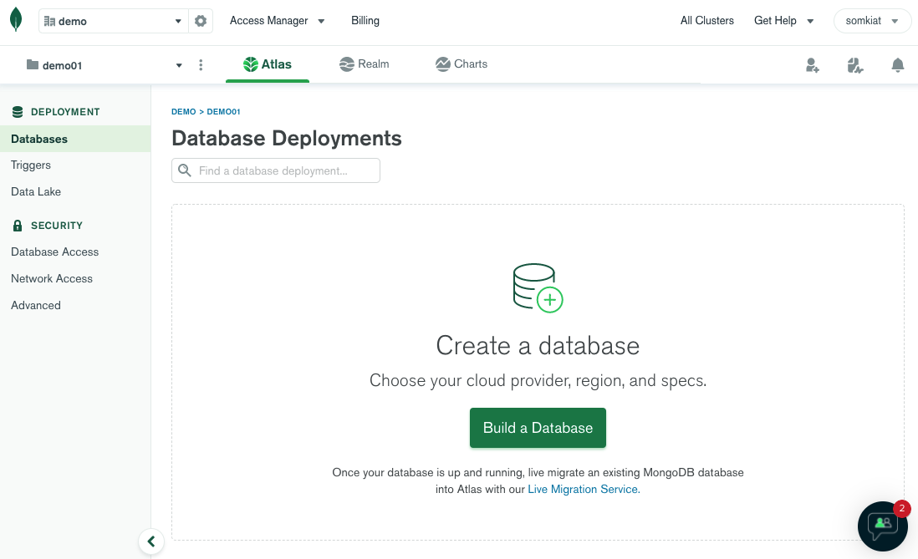
On cloud (Atlas)

Slide 31
CRUD operations
In mongo shell

Slide 32
CRUD operations
Operation | Example
Create | insertOne() insertMany()
Read | find() - criteria, limit, sorting
Update | updateOne() updateMany() replaceOne()
Delete | deleteOne() deleteMany()
Upsert (Update or insert) | updateOne(… “upset”: true )

Slide 33
Build write operations
Write one or more documents
Transaction per document
Ordered vs Unordered operation
Use bulkWrite()

Slide 34
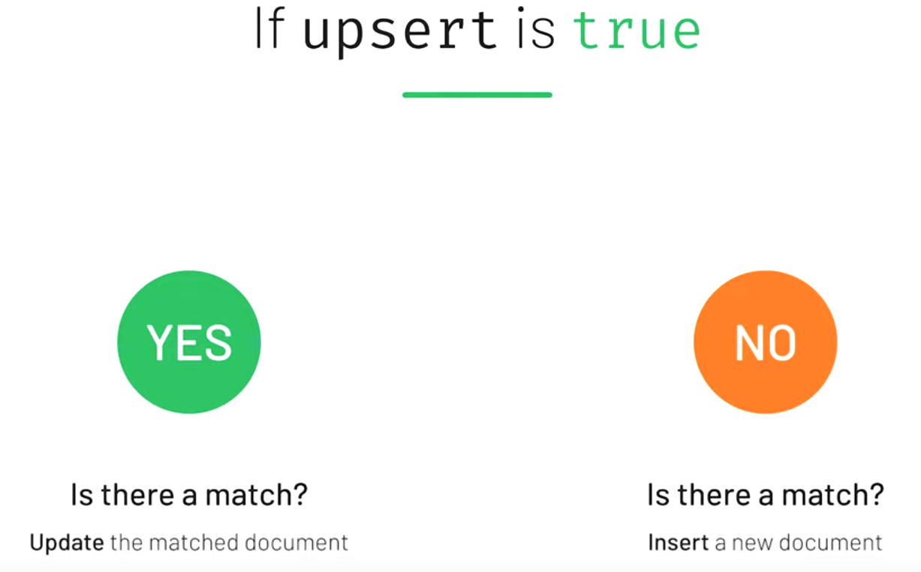
Upsert ?

Slide 35
Workshop

Slide 36
MongoDB Query Language (MQL)
Query abd projection operator
Update operator
Comparison operator
Aggregation pipeline

Slide 37
Comparison operator
Operator | Description
$eq | Equal to
$ne | Not equal to
$gt | Greater than
$gte | Greater than or equal
$lt | Less than
$lte | Less than or equal

Slide 38
Update operator
Modify data in database
$inc, $set and $unset

Slide 39
Aggregation pipeline
Another way to query data in MongoDB
Powerful to transform data
Break down a complex query in to easier stages
Collection
Stage 1
Stage 2
Stage n
Output
https://docs.mongodb.com/manual/core/aggregation-pipeline/

Slide 40
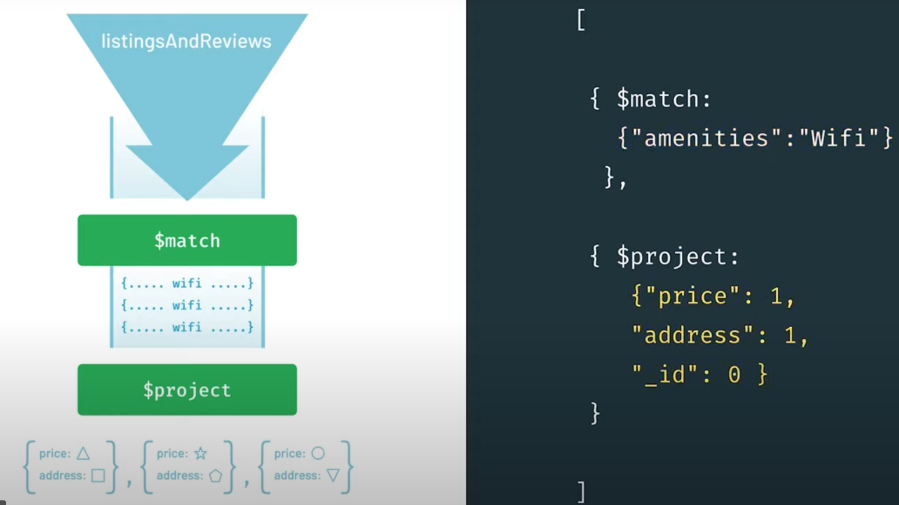
Aggregation pipeline

Slide 41
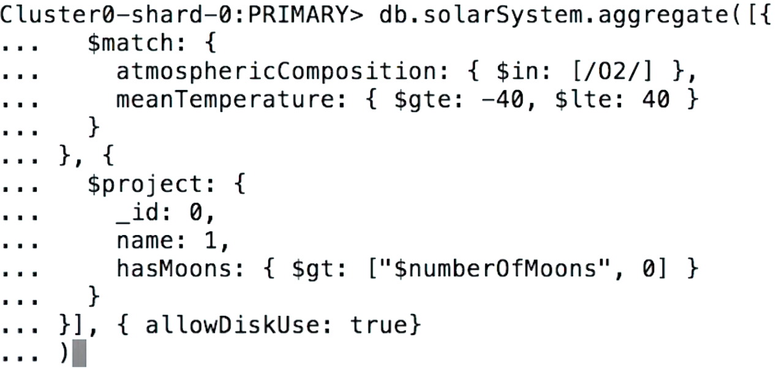
Syntax
https://docs.mongodb.com/manual/meta/aggregation-quick-reference/

Slide 42
Workshop

Slide 43
Data modeling
https://docs.mongodb.com/manual/core/data-modeling-introduction/

Slide 44
Data modeling in MongoDB
Way to organize fields in a document
To support your application performance
And query capabilities
Design for read !!

Slide 45
Normalization
Design for write or read ?

Slide 46
Denormalization
Design for write or read ?

Slide 47
Comparison
Normalization | Denormalization
Non-redundant and consistency data | Combine data that can be query more speed
More tables and joins | Decrease tables and joins
Optimized usage | Wastage
No redundant data | More redundant data
Design for write | Design for read

Slide 48
MongoDB Rule
Data is stored in the way
that it is used

Slide 49
More questions ?
How it will be queried ?
Who is using our application ?
Ratio between reads and writes ?
Design for users

Slide 50
Keep in mind
Data that is used together should be stored together
Evolving application implies an evolving data model too
Performance issues

Slide 51
Data modeling phases
Workload (data size, read/write)
Relationships
Patterns (optimization)

Slide 52
Document structures
Embedded data
References

Slide 53
Relationships
One-to-one
One-to-many
Many-to-many

Slide 54
One-to-One

Slide 55
One-to-One
User
Address
Embed vs Reference ?

Slide 56
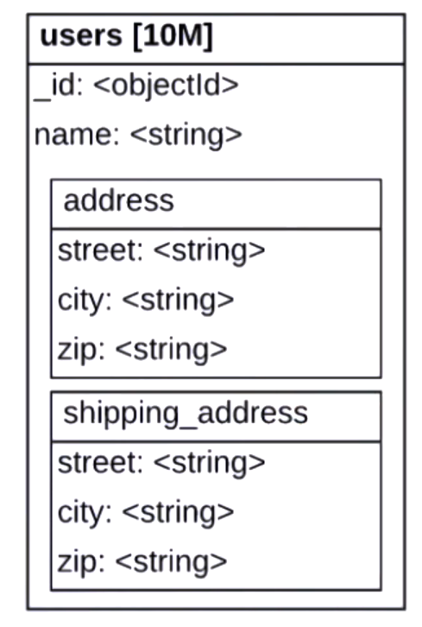
One-to-One
Embed vs Reference ?

Slide 57
One-to-One
Store
Store detail
Embed vs Reference ?

Slide 58
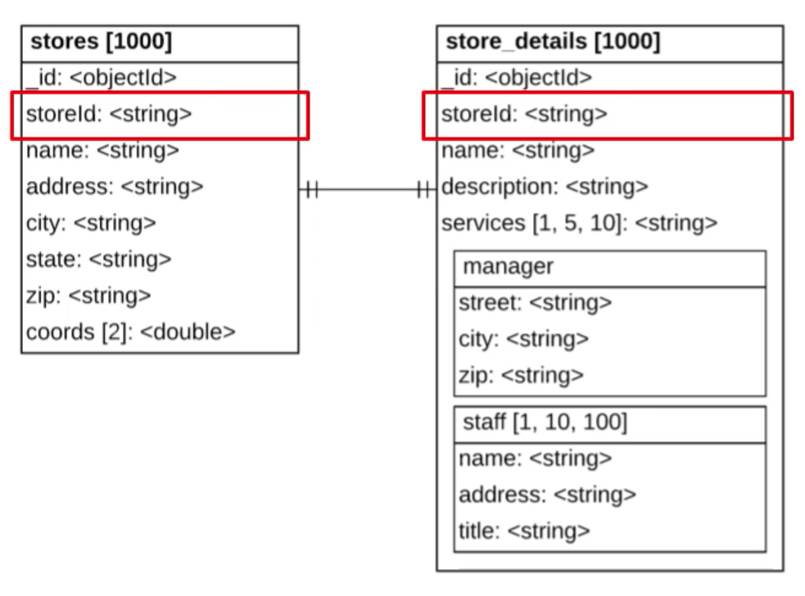
One-to-One
Embed vs Reference ?

Slide 59
One-to-One
Prefer embedding over reference for simplicity
Use subdocuments to organize the fields
Use reference for optimization purpose

Slide 60
One-to-Many

Slide 61
One-to-many !!
A mother and children ?
A person and address ?
Embed vs Reference ?

Slide 62
One-to-many
One-to-zillion
One-to-many (low)

Slide 63
One-to-Many
Product
Top review users
Embed vs Reference ?

Slide 64
One-to-Many
Order
Product item
Embed vs Reference ?

Slide 65
One-to-Many
Province
Stores
Embed vs Reference ?

Slide 66
One-to-Many
Province
Stores
Stores = [1,2,3,4]
Embed vs Reference ?

Slide 67
One-to-Many
Province
Stores
provinceId = 1
Embed vs Reference ?

Slide 68
One-to-Many
Province
Stores
Stores = [1,2,3,4]
provinceId = 1
Embed vs Reference ?

Slide 69
One-to-Many
A Lot of choices
Choose the side between one and many
Duplication when use embedding
Embed on the side of the most query
Prefer referencing when associated documents are not always needed with often query documents

Slide 70
Many-to-Many

Slide 71
Many-to-Many
Cart
Items
Embed vs Reference ?

Slide 72
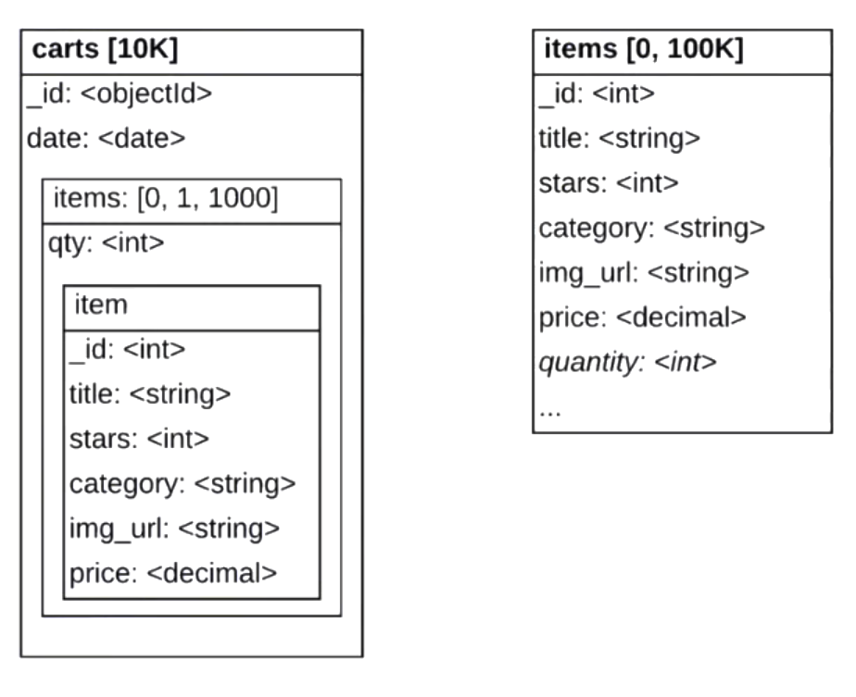
Many-to-Many
Keep in other collection
Embed document

Slide 73
Many-to-Many
Items
Stores
Find all items sold in each store ?
Embed vs Reference ?

Slide 74
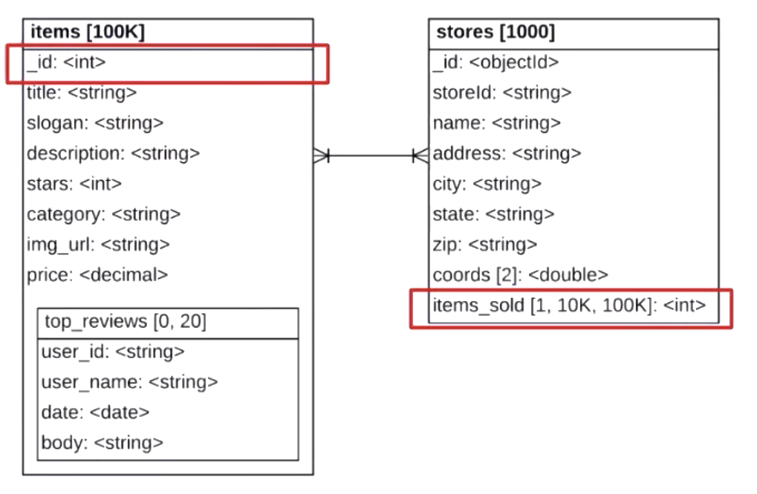
Many-to-Many

Slide 75
Many-to-Many
Prefer reference over embedding to avoid duplication
Prefer embedding on the most query side

Slide 76
Workshop

Slide 77
MongoDB Deployment

Slide 78
Goals
Architecture of a sharded cluster
Query handling in a sharded cluster
Data distribution method

Slide 79
Sharding
Distributing data across multiple machines
Horizontal scaling
In MongoDB with large data sets,
needed high throughput operations

Slide 80
Sharding
1 TB
Collection A
Shard 1
Shard 2
Shard 3
Shard 4
256 GB
256 GB
256 GB
256 GB

Slide 81
When to use Shards ?
Write workload on a single server exceed that server’s capacity
Working set no longer fits into RAM
Single server can no longer handle the size of data set

Slide 82
Shard key
Use to determine how documents in a collection are distributed across the shards
Collection A
Shard 1
Shard 2
Shard 3
Shard 4

Slide 83
Shard key
Use to determine how documents in a collection are distributed across the shards
https://docs.mongodb.com/manual/core/sharding-shard-key/

Slide 84
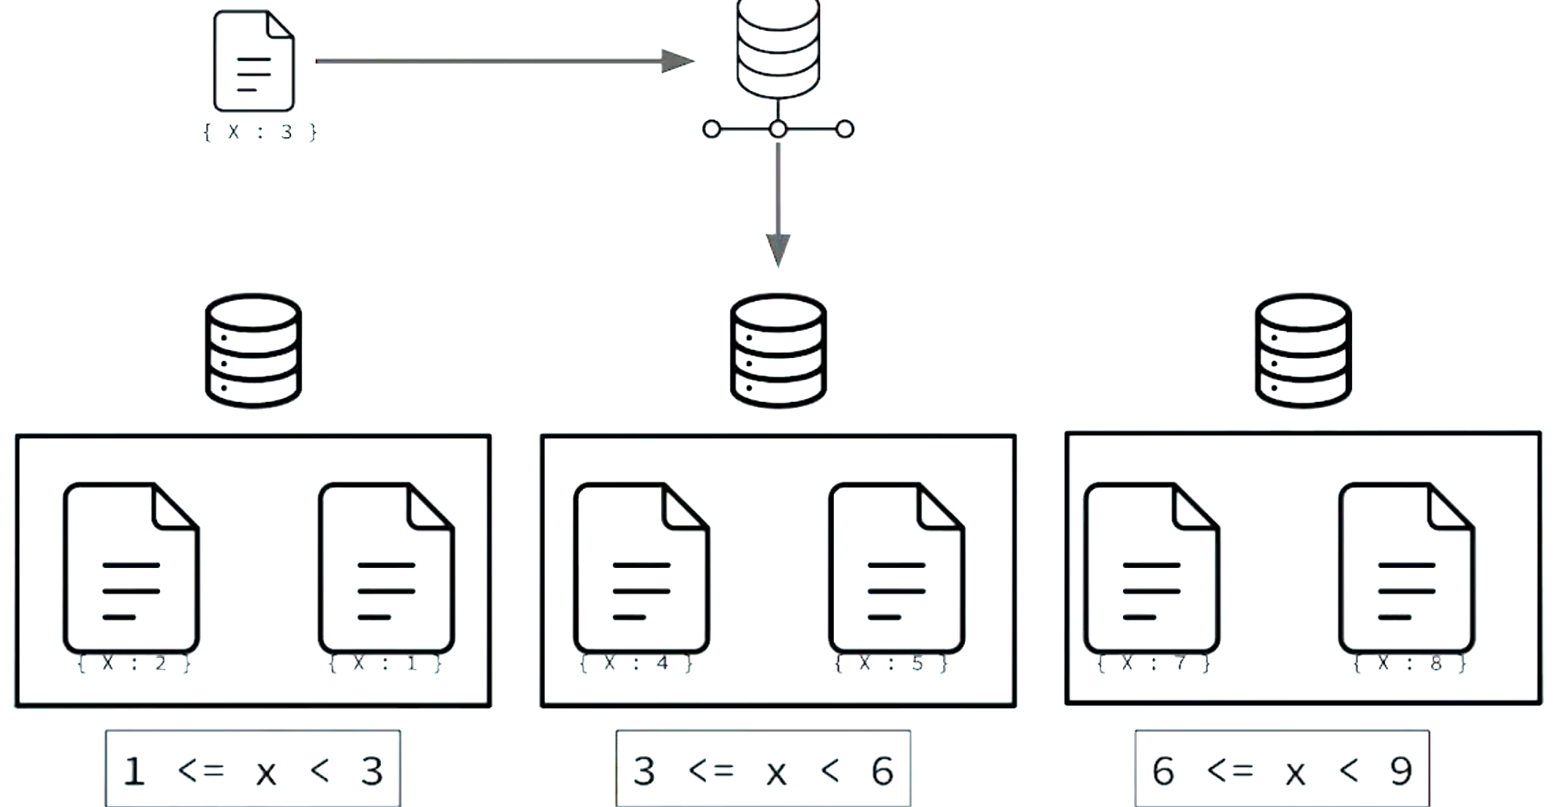
Shard key
1. Create a document

Slide 85
Shard key
2. Calculate shard key

Slide 86
Shard key
2. Calculate shard key

Slide 87
Shard key
Must be indexed
Immutable (can’t be change)
Permanent

Slide 88
How to Shard ?
Enable sharing to db
Create index for shard key
sh.shardCollection() to shard the collection

Slide 89
Choose shard key ?
The goal is a shard key whose values provides good write distribution
Cardinality
Frequency
Monotonic change

Slide 90
Hashed Shard key
Single field hashed index
Compound hashed index
https://docs.mongodb.com/manual/core/hashed-sharding/

Slide 91
Workshop

Slide 92
MongoDB Deployment
Standalone or Cluster
Replication
Shard cluster

Slide 93
Replication Deployment
https://docs.mongodb.com/manual/replication/

Slide 94
Shard Cluster Deployment
https://docs.mongodb.com/manual/core/sharded-cluster-components/

Slide 95
Shard Cluster Deployment
https://docs.mongodb.com/manual/core/sharded-cluster-components/

Slide 96
Shard Cluster Deployment
Shard 1
Router
Application
Mongos
Shard 2
Shard 3

Slide 97
Shard Cluster Deployment
Shard 1
Router
Application
Mongos
Shard 2
Config shard Servers
Shard 3

Slide 98
Query from shard cluster
sort()
limit()
skip()
https://docs.mongodb.com/manual/core/distributed-queries/

Slide 99
Query from shard cluster
sort()
The mongos pushes the sort to each shard and merge-sorts the result
limit()
The mongos passes the limit to each targeted shard, then re-applies the limit to the merge set of results
skip()
The mongos performs the skip against the merged set of results

Slide 100
Targeted vs Scatter gather query
Targeted queries requires the shard key
Without shard key, the mongos must perform a scatter-gather query

Slide 101
Targeted query
Shard key

Slide 102
Scatter gather query
No Shard key

Slide 103
Workshop

Slide 104
Security

Slide 105
Security in MongoDB
User authentication
Role-Based Access Control (RBAC)
Internal communication authentication

Slide 106
Authentication vs Authorization

Slide 107
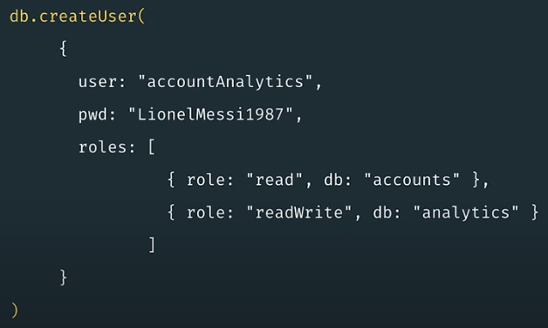
Working with MongoDB
Create user document

Slide 108
Working with MongoDB
Create roles of user

Slide 109
Quality Assurance feedback
Database is secure ?
Database allows users to perform commands without authenticating first !!
Update configs
Shutdown
Start

Slide 110
Workshop

Slide 111
Role-Based Access Control

Slide 112
Role-Based Access Control

Slide 113
Role-Based Access Control
Build-in roles
User-defined roles
https://docs.mongodb.com/manual/core/authorization/

Slide 114
Build-in roles
MongoDB provides build-in roles to offer a set of privileges that are commonly needed in a database system
https://docs.mongodb.com/manual/reference/built-in-roles/

Slide 115
Build-in roles

Slide 116
Build-in roles
Group name | Roles
Database user | read readWrite
Database administration | dbAdmin userAdmin dbOwner
Cluster admin | clusterManager, clusterMonitor hostManager, clusterAdmin
Backup and restore | backup restore
All databases | readAnyDatabase, readWriteAnyDatabase userAdminAnyDatabase, dbAdminAnyDatabase
Superuser | dbOwner,userAdmin userAdminAnyDatabase

Slide 117
Workshop

Slide 118
User-defined roles
If build-in roles do not provide all the expected privileges, database administrators can be define custom roles using the createRole()
https://docs.mongodb.com/manual/core/security-user-defined-roles/

Slide 119
Why create user-defined roles ?
Fine-grained control to user administrators
Build-in roles grant too many privileges
User admin can adhere
to the Principle of Least Privilege (PoLP)

Slide 120
Principle of Least Privilege

Slide 121
Principle of Least Privilege
Users should have the least privilege required for their intended purpose
https://en.wikipedia.org/wiki/Principle_of_least_privilege

Slide 122
User-defined roles
Method name | Description
db.createRole() | Create a role and its privileges
db.updateRole() | Update the user-defined role
db.dropRole() | Delete a user-defined role
db.grantPriviledgesToRole() | Assigns new privileges to a role
db.revokePriviledgesFromRole() | Removes privileges from a roles

Slide 123
Build-in role : userAdmin
List of privilege actions
changeCustomData | grantRole
changePassword | revokeRole
createRole | setAuthenticationRestriction
createUser | viewRole
dropRole | viewUser
dropUser

Slide 124
Build-in role : userAdmin
Need only 3 privilege actions for this role
changeCustomData | grantRole
changePassword | revokeRole
createRole | setAuthenticationRestriction
createUser | viewRole
dropRole | viewUser
dropUser

Slide 125
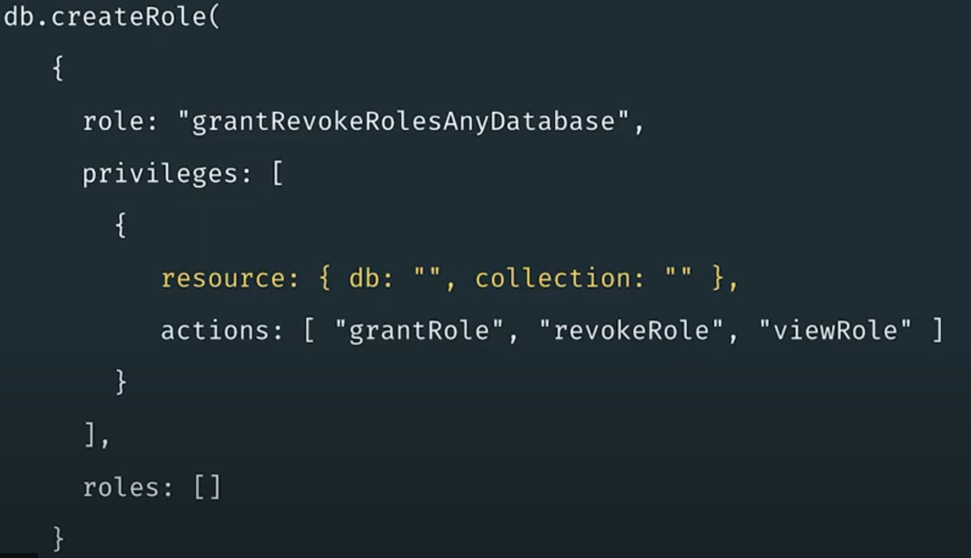
Create new role
For all databases and collections

Slide 126
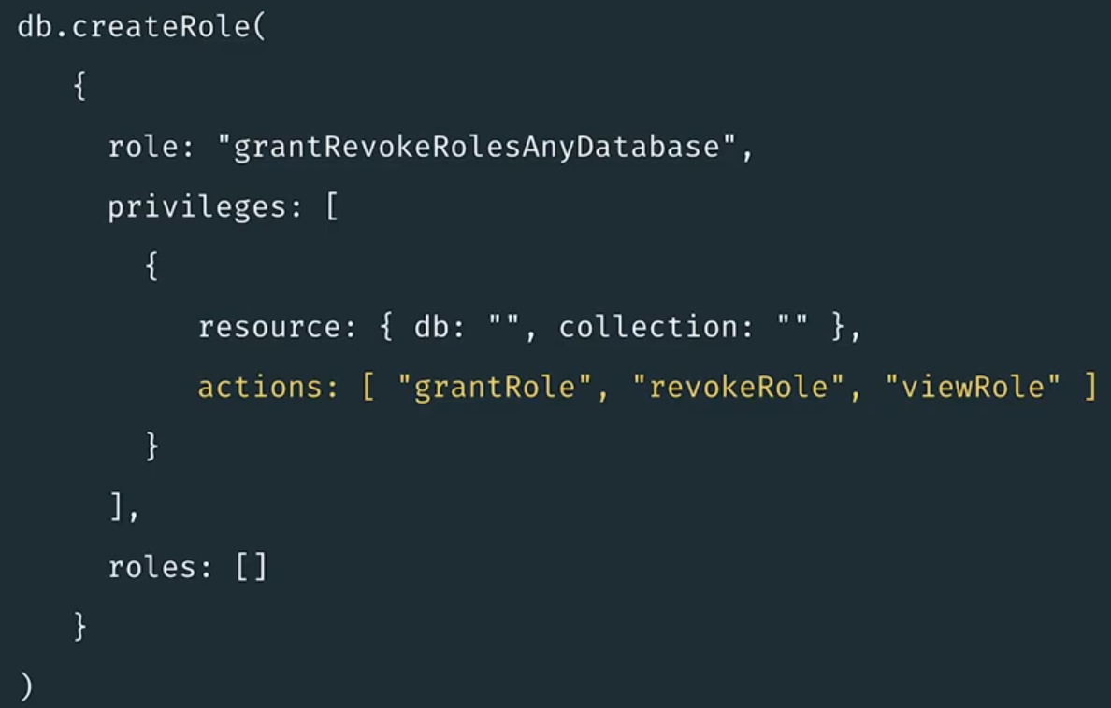
Create new role
Add privilege actions to this role

Slide 127
Workshop

Slide 128
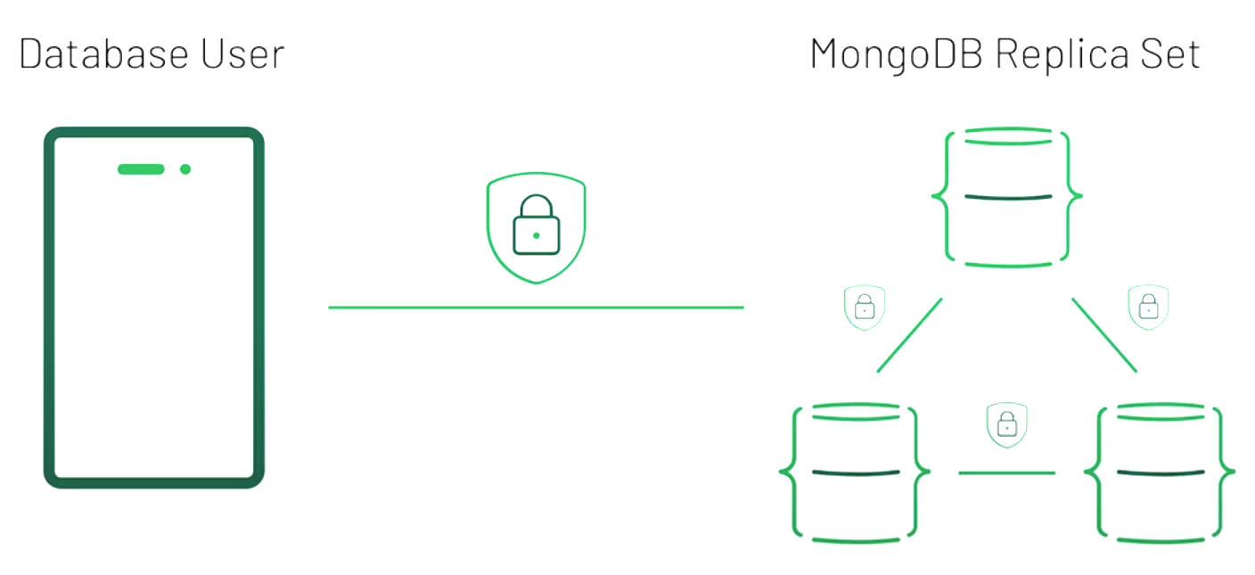
Internal Authentication ?
To verify the identity of one MongoDB instance to another
https://docs.mongodb.com/manual/core/security-internal-authentication/

Slide 129
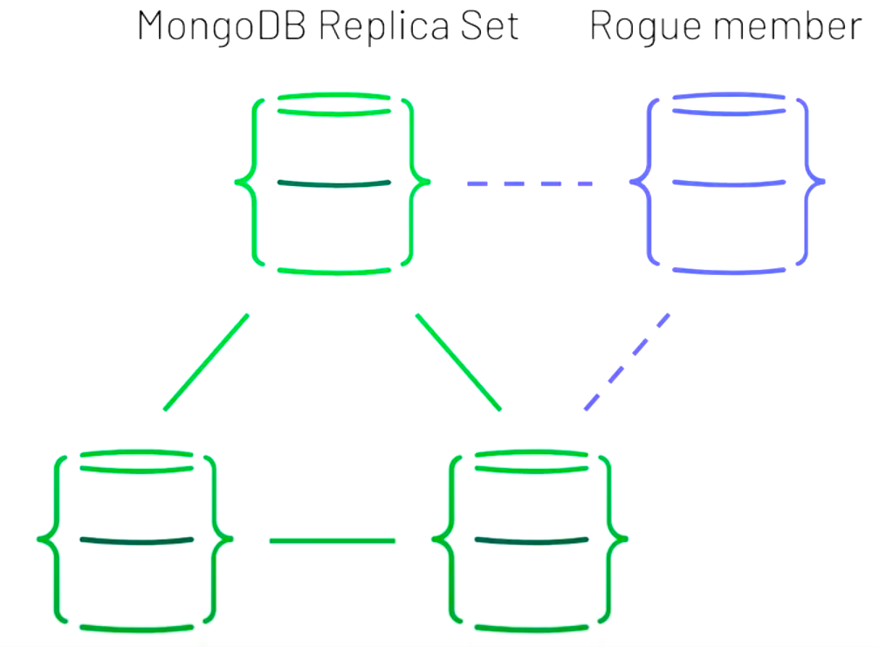
Replica sets without internal communication
Attacker

Slide 130
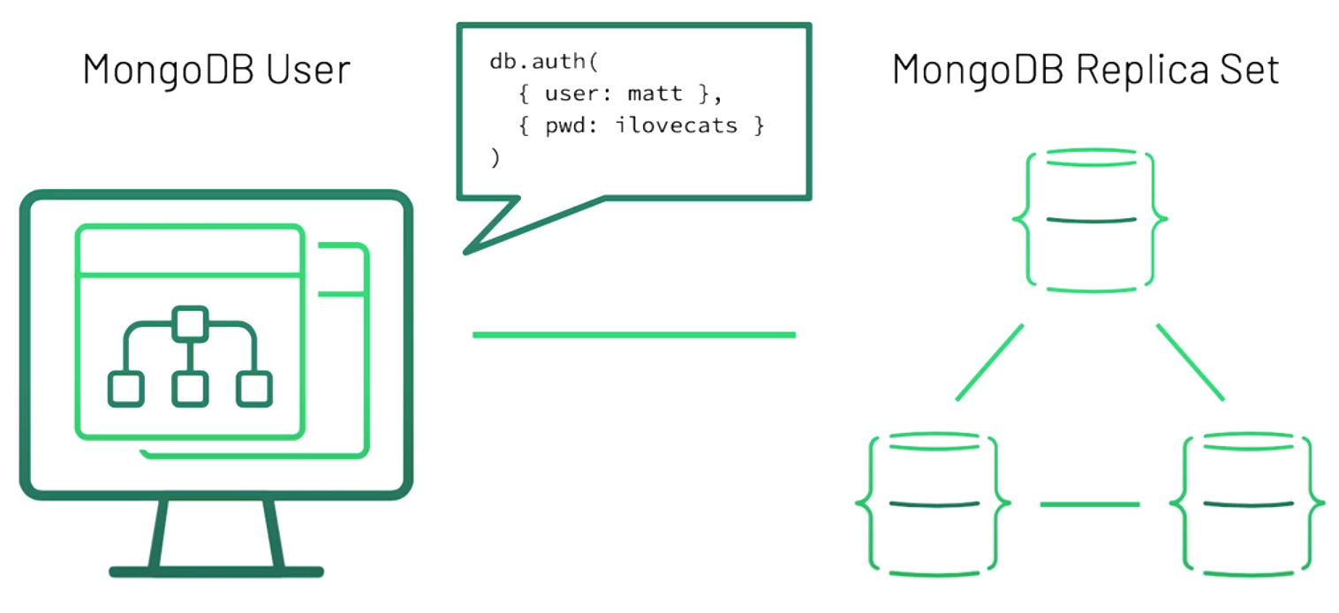
SCRAM
Use keyfile
Default authentication for MongoDB
https://docs.mongodb.com/manual/core/security-scram/

Slide 131
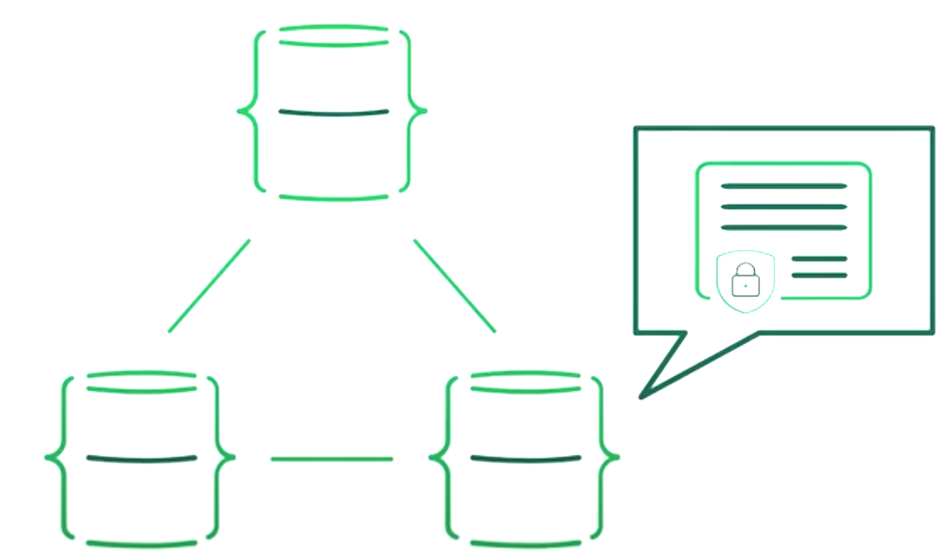
x.509 certificates
https://docs.mongodb.com/manual/core/security-x.509/

Slide 132
x.509 certificates
Verify members of replica set are authenticating to each other
Encrypt sent over the network

Slide 133
Workshop

Slide 134
Performance

Slide 135
Performance
Hardware
Configuration
Indexes
CRUD optimization
Performance on cluster

Slide 136
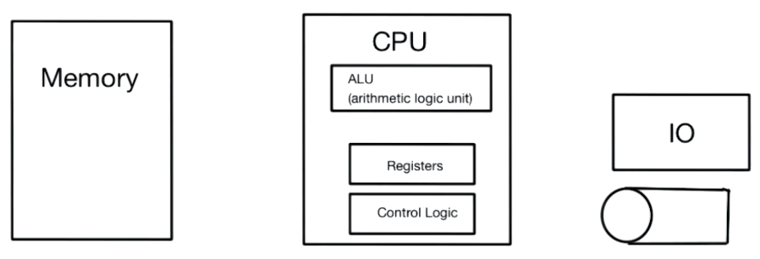
Hardware

Slide 137
Memory with MongoDB
Aggregation
Index traversing
Write operations
Query engine
Connections

Slide 138
CPU with MongoDB
Storage engine
Concurrency model

Slide 139
Indexed
https://docs.mongodb.com/manual/indexes/

Slide 140
Indexes
Make query more efficient
Most impactful ways to improve query performance

Slide 141
Index types
Single
Compound
Multikey
Geospatial
Text
Hashed

Slide 142
Better indexes ?
Build the right indexes for your criteria
Learn how to MongoDB picks a index
Improve query performance with explain
Learn about other index types

Slide 143
Avoid sorting !!
https://docs.mongodb.com/manual/tutorial/sort-results-with-indexes

Slide 144
Working with Distributed system
Consider latency
Data is spread across different nodes
Read and Write operations

Slide 145
Increase write performance
Vertical vs Horizontal scale
Shard key rules
Bulk write

Slide 146
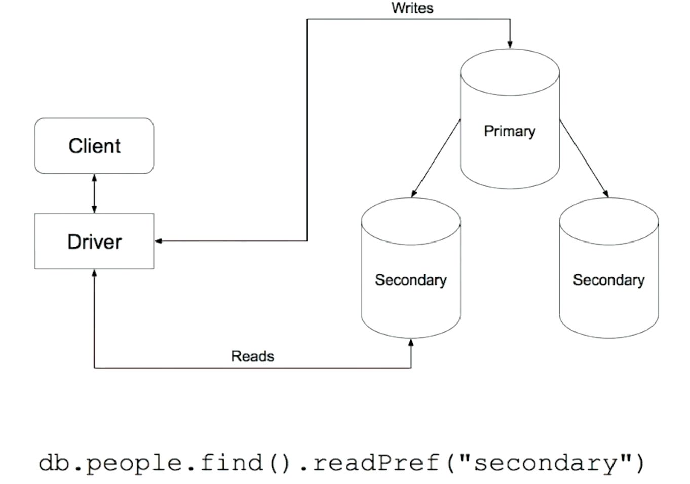
Read from secondary
Eventually consistency

Slide 147
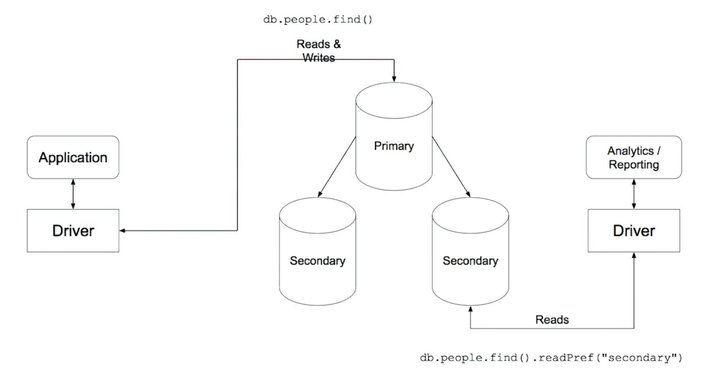
Use case

Slide 148
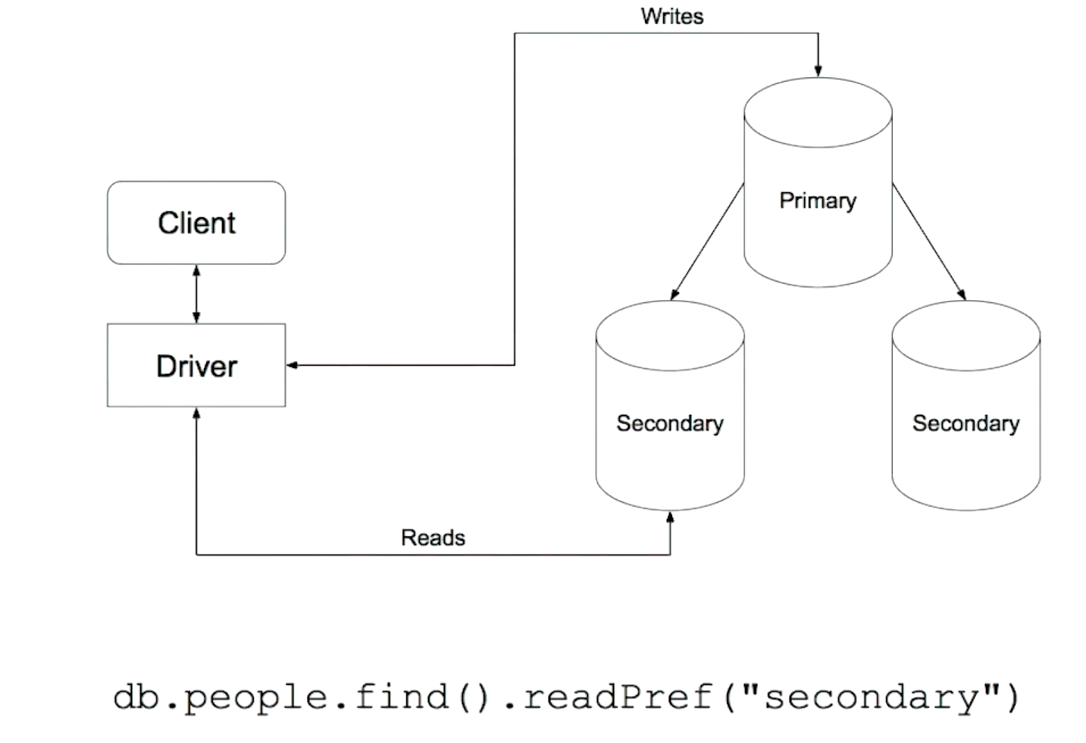
Be careful !!
Read from secondary

Slide 149
Workshop

Slide 150
Q/A

